Slide 1

Note: The data and information in this document is reflective of a hypothetical situation and client. This document is to be used for KPMG Virtual Internship purposes only.
Sprocket Central Pty Ltd
Data analytics approach
[Division Name] - [Engagement Manager], [Senior Consultant], [Junior Consultant]

Slide 2
Note: The data and information in this document is reflective of a hypothetical situation and client. This document is to be used for KPMG Virtual Internship purposes only.
Agenda
Introduction
Data Exploration
Model Development
Interpretation

Slide 3
Note: The data and information in this document is reflective of a hypothetical situation and client. This document is to be used for KPMG Virtual Internship purposes only.
Introduction
Customer targets to drive the most value based on existing customer data.
Identify customer segments that are most valuable to the company using:
Data exploration
Modelization
Analysis and reporting
Identifying and Recommending High Value Customers
Problem Statement:
Sporocket is a company that deal in high quality bikes and accessories.
The motive is to boost the bike sales
Finding the 1000 new value customers that would lead to higher value in business.
Analyzing data on demographic, gender, jobs and industry level to find the new customers from the 3 datasets available.

Slide 4
Note: The data and information in this document is reflective of a hypothetical situation and client. This document is to be used for KPMG Virtual Internship purposes only.
Data Exploration
Data Quality Assessment
- Key data quality issues and amendment
 | Accuracy | Completeness | Consistency | Currency | Relevancy | Validity
Customers Demographics | Age: Missing DOB: Inaccurate data type | Job Title: blanks | Gender: Inconsistency | Deceased customers filtered out | Column with irrelevant information removed
Transaction | Profit: missing Transaction month: missing | Brands: blank Online Order: blank | Price and date format: incorrect |  | Order_status: cancelled filtered out | Sold_date: format Price: format
Customer Address |  |  | States: inconsistence

Slide 5
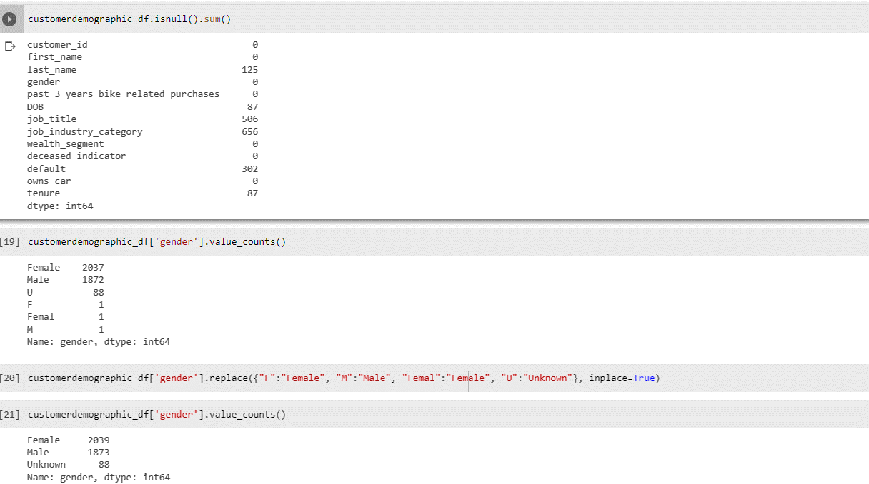
Note: The data and information in this document is reflective of a hypothetical situation and client. This document is to be used for KPMG Virtual Internship purposes only.
Data Exploration
This an exemple of exploring data that I used on Customers demographic table, New customers and customers adresses

Slide 6
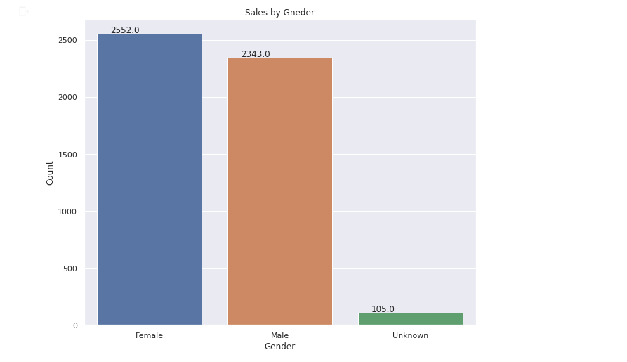
Note: The data and information in this document is reflective of a hypothetical situation and client. This document is to be used for KPMG Virtual Internship purposes only.
Model Development
Bike purchases last 3 years
As we can see, our new customers mostly Female are the most important customers, with purchases of total of 2552,0 bikes.
Male contributed to the purchases with 2343,0 bikes
And we have a small category of unknown gender with 105,0 bikes purchased.

Slide 7
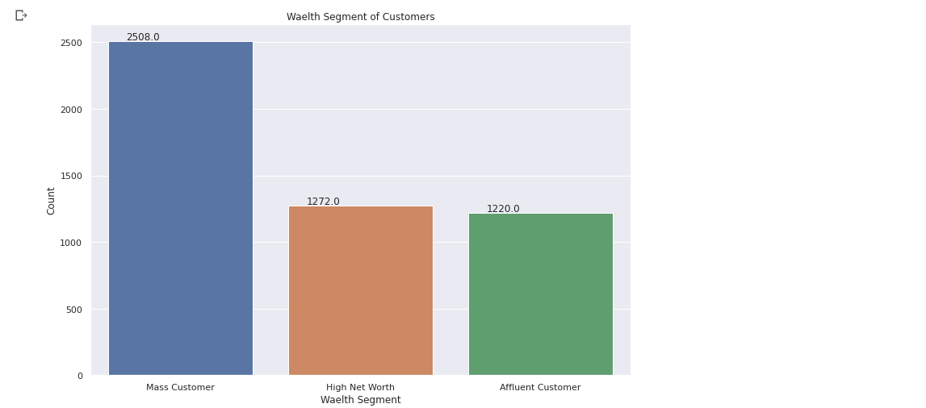
Note: The data and information in this document is reflective of a hypothetical situation and client. This document is to be used for KPMG Virtual Internship purposes only.
Interpretation
Wealth segments
Concerning the segmentation by wealth:
We can identify that the most important customers category are Mass Customer.
Then we have High Net worth wealth segment in the second position and affluent customer in the third position.

Slide 8
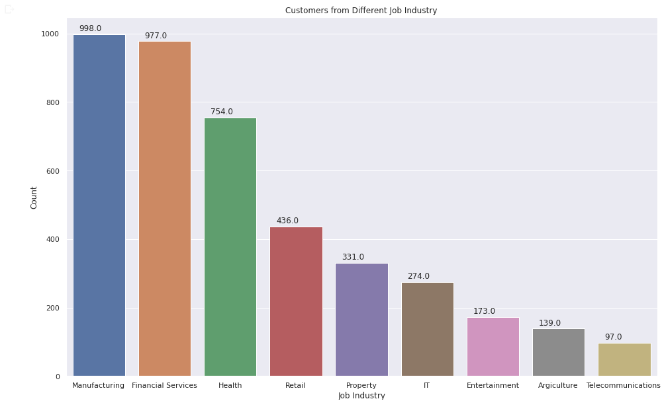
Note: The data and information in this document is reflective of a hypothetical situation and client. This document is to be used for KPMG Virtual Internship purposes only.
Interpretation
Segments by jobs
Going into the segmentation by jobs:
We can identify that the most important jobs are in the Manufacturing.
Then we have Financial service in second position and Health job in the third positions.

Slide 9
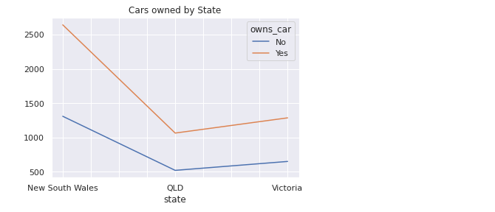
Note: The data and information in this document is reflective of a hypothetical situation and client. This document is to be used for KPMG Virtual Internship purposes only.
Interpretation
Segments by State
Going into the segmentation by States:
We can identify here 3 states New South Wales , QLD state and Victoria.

Slide 10
Note: The data and information in this document is reflective of a hypothetical situation and client. This document is to be used for KPMG Virtual Internship purposes only.
Appendix

Slide 11
Note: The data and information in this document is reflective of a hypothetical situation and client. This document is to be used for KPMG Virtual Internship purposes only.
Report and interpretation
Most valuable customers:
Customers in NSW, but all states should be considered to maximize profits.
Female customers are important.
Mass Customers and High Net Worth
Customers that work in Manufacturing and Financial Services, Health.
All supporting items in that attachment:
https://github.com/Sisirine/KPMG-Vitual-Data-Analysis-Internship/blob/main/KPMG_Data_Analysis%20(1).ipynb

